Slide 1

IW
Strategy Review
December 2, 2005

Slide 2
Objectives for Today
  Present IW’s business goals for FY09 and get your initial feedback on our aspiration and approach
  Discuss the following three key strategies that will help realize our goals:
    Pricing & Packaging Excellence
    Service-based IW Offerings
    Office Business Apps, BI, LOBi & Specialized Usage
  Provide a short overview of other IW initiatives underway or in the planning stage
  Summarize our discussion and key asks; lay out next steps
Microsoft Confidential
IW Strategy Review FY06
Notes:
We’ll spend 90 minutes on each topic and try to present our key ideas in less than an hour, leaving time to review and discuss your reactions and suggestions. We’ll incorporate your thoughts into our thinking and action plans and schedule follow-on meetings as necessary

Slide 3
Agenda / Schedule
IW Goals and Introduction to Key Topics 9 – 9:30a
1 - Pricing & Packaging Excellence ~9:30 – 11a
2 - Service-based IW offerings ~11:00a – 12:30p
3 - Office Business Apps, BI, LOBi & Specialized Usage ~12:30 – 2p
Summary & Next Steps ~2:00 – 3p
Microsoft Confidential
IW Strategy Review FY06

Slide 4
Setting Big Aspirations for 2009 Economic Value
Our ambition is to grow the IW business to an EV of $180B by FY09
IW Economic Value
$Billions
2009 EV Goal
$180B
$16
Gap
$14
Emerging
Categories
RTC/UC
Services
OBA/BI
$12
$1
Office Server
Licenses
CALs
$15
$7
Established
Categories
Project
Visio
$123
$11
Net EV gain
Core Office
Base EV (Total = $120B)
$101⁽¹⁾
Base EV of $120B (Based on internal analysis, not-discounted)
Forecast EV will grow to $164B by FY09, a $44B gain
(Not to Scale)
$101
(Not to Scale)
Wall Street View
Jul ’05
Low Growth Rate
<10%
Medium Growth Rate
10% - 20%
High Growth Rate
> 20%
⁽¹⁾ Discount of 20% applied to internal EV calculation
Microsoft Confidential
IW Strategy Review FY06
Notes:
Set big goals… then invest in different products and markets, each with different growth rates and investment requirements to achieve optimal overall business growth
** Making investments to defend and extend Core Office and in, high growth opportunities – RTC/UC, Services and OBA/BI
Double IW’s economic value from $101B in July 2005 to $202B by FY10 year end. Total adjusted revenue would grow from $14B to about $22B, an overall growth rate of about 10%
To Do’s:
Niklas / Sam How much of EV total from each bucket today?
Review all #s, tie to latest LRP, EV model. Provide speaking points
Resize buckets to scale
Check gap $$

Slide 5
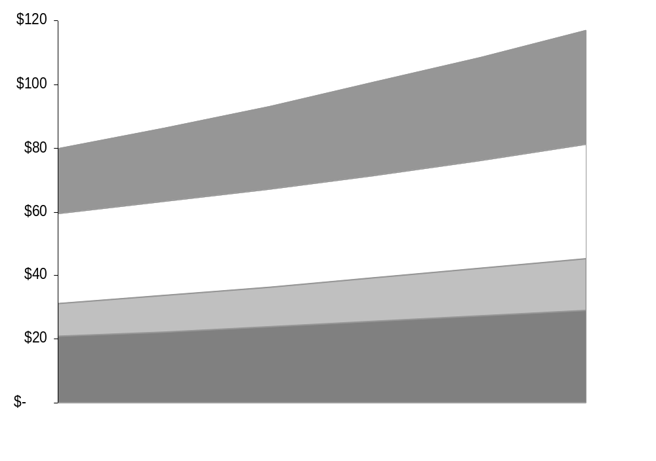
Addressing Big, New Market Segments Drives Our Growth Aspiration
By 2009, IW will be addressing four large market segments totaling over $115B
IW Addressable Market Segments
$Billions
2009 Avail. Market &
5-Year CAGR
~$36B
~11.2%
Services⁽¹⁾
Size of market segments
IW will address by ‘09
~$36B
~5.0%
Unified Comm.
~$16B
~9.5%
OBA / BI⁽²⁾
Size of market segments
IW addressed
in ‘04
~$29B
~6.7%
Core IW Productivity Software
2004
2009
⁽¹⁾Services excludes SMS (Est. TAM of $51B), ⁽²⁾OBA/BI excludes specialized apps
Source: IDC, McKinsey & MS analysis
Microsoft Confidential
IW Strategy Review FY06
Notes:
In 2002 IW set out to deliver $20B in revenue within 6 years, from a base of $9B. But we had to establish ourselves in other, more rapidly growing markets or risk missing out on $30B in new growth
So we took a portfolio approach to our business, maintaining and defending the core while nurturing new “category” businesses
To Do’s:
Sam / Anne - Check all #s, tie to topics, provide speaking notes

Slide 6
Agenda / Schedule
IW Goals and Introduction to Key Topics 9 – 9:30a
1 - Pricing & Packaging Excellence ~9:30 – 11a
2 - Service-based IW offerings ~11:00a – 12:30p
3 - Office Business Apps, BI, LOBi & Specialized Usage ~12:30 – 2p
Summary & Next Steps ~2:00 – 3p
Microsoft Confidential
IW Strategy Review FY06

Slide 7
IW Pricing Excellence Can Drive Growth
Discussion topics:
Review our Office 12 packaging which is designed to drive growth from the core
Discuss some key challenges to our current business model and a variety of ideas to combat them
Spend time on 2 ideas: Office Trials and ad-funded Works to drive growth from the core
Our Asks:
Support the Office 12 packaging and provide feedback given that announce is scheduled for Feb 15th
Input on prioritizing the challenges to identify areas where we’re under-invested
Feedback on trials and ad-funded Works
Microsoft Confidential
IW Strategy Review FY06

Slide 8
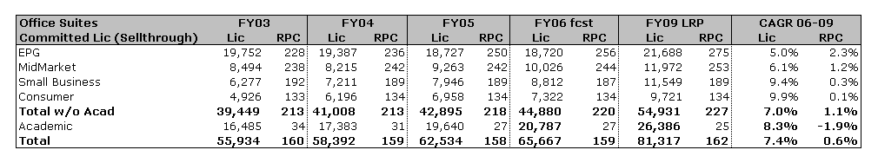
O12 Packaging to Drive Growth from the Core
RPC & committed licenses are healthy today with future growth driven by O12 lineup
1
2
Office 12: good-better-best suites by segment to price optimize and encourage up sell
  We’re introducing a high-end Office “Premium” with OneNote & Groove for collaboration and mobile users
  We’re monetizing new value in Office Pro Enterprise with a 5% price increase without changing the price of Office Pro in OEM
  We’re further differentiating Office Pro Enterprise from Office Standard
  We’re introducing Office Small Business Accounting in the UK and Germany
  We’re likely to broaden Student & Teacher to home users and replace Outlook with OneNote to discourage small business cannibalization
3
Office 12: six enterprise servers plus an easier way to buy all the CALs for a broad set of Microsoft servers
  We’re combining SharePoint Portal Server and Content Management Server into one product likely called Office SharePoint Server
  We’re adding new capabilities to Office “Communication” Server, Office Project Server and Office Groove Server
  We’re introducing two new targeted servers: Office “Forms” Server and Office “Biz#” Server
  We’re introducing tiered CALs to provide greater customer flexibility within product lines
  We’re introducing a high-end “Premium” CAL to enable the best communication, collaboration and compliance scenarios for our customers
Microsoft Confidential
IW Strategy Review FY06

Slide 9
Segment Based Differentiation Is Key to Office Suite Growth
Solidifying the boundaries between products and segments is critical today and in O14
 | O12 SKU | Why Move Up? | O12 Lever
Up-sell | “Premium” | Groove, OneNote | 1 pt mix shift = $10M
Hero | Pro Enterprise | InfoPath, Access, Publisher IRM, workflow, content management initiation | 1% price increase = $68M
Fallback | Standard | Word, Excel, PowerPoint, Outlook
Enterprise
FY06 RPC = $256
1
Why enterprise and mid-market customers shouldn’t buy through OEM
Pro Enterprise feature differentiation from Pro: InfoPath and IRM, workflow, content management initiation
Volume and annuity license benefits like re-imaging, no activation needed, downgrade rights, deployment services, e-learning, home use rights
1 point of mix shift from Pro Enterprise down to Pro is $1M lost (RPL)
 | O12 SKU | Why Move Up? | O12 Lever
Up-sell | Pro / SBME | Access / Small Business Accounting | 1 pt OEM mix = $5M
Hero | SBE | PowerPoint, BCM technology, Publisher | 1 pt OEM attach = $28M
Fallback | Basic (OEM) Trial + Works | Word, Excel, Outlook | 1 pt OEM attach = $23M
Small Business
FY06 RPC = $187
2
Why small business customers shouldn’t buy Office Student & Teacher
License restricts Student and Teacher to non-business use
No Outlook, no business contact management technology, no Publisher
1 point of mix shift from Small Business down to Basic is $5M lost, 1 point of mix shift from Small Business to “Student & Teacher” is $7M lost
 | O12 SKU | Why Move Up? | O12 Lever
Up-sell | Pro | Outlook, Access, commercial use | 1 pt mix = $13M
Hero | Student & Teacher | PowerPoint, OneNote (but no Outlook) | 1 pt conversion = $20M
Fallback | Basic (OEM) Trial + Works | Word, Excel, Outlook | 1 pt OEM attach = $64M
Consumer
FY06 RPC = $134
3
Microsoft Confidential
IW Strategy Review FY06

Slide 10
“Premium” CAL for Easy Purchase of Broad Servers
Enables compliance, communication & collaboration scenarios for the New World of Work
1
We have lots of servers to market and sell
2
“Premium” CAL makes it easy to buy CALs to broad servers (at twice the price of Core CAL)
Server Name | BG | Licensing
Windows Server (and RMS, TS) | S&T | 3 CALs, workload
SQL Server | S&T | CALs, per-proc
Exchange Server | S&T | 2 CALs
Office “Communication” Server | IW | 3 CALs
Office SharePoint Server | IW | 2 CALs
Office Project Server | IW | 1 CAL
Office “Biz#” Server | IW | 2 CALs
Office Groove Server | IW | Per server
Office Forms Server | IW | 1 CAL
BizTalk Server | S&T | Per-proc
Commerce Server | S&T | Per-proc
Speech Server | S&T | Per-proc
Windows Storage Server | S&T | OEM
Identity Integration Server | S&T | Per-proc
Internet Security & Acceleration Server | S&T | Per-proc
Host Integration Server | S&T | Per-proc
Microsoft Virtual Server | S&T | Per server
System Center Operations Manager | S&T | Per-proc
System Center Configuration Manager | S&T | Per-proc
System Center Data Protection Manager | S&T | Per-proc
System Center Reporting Manager | S&T | Per-proc
System Center Capacity Planner | S&T | Per-proc
MapPoint Location Server | S&T | Platform access
MS CRM | MBS
More…
“Premium” CAL
(54% off additional CALs, 39% off total)
FB
RMS
Desktop
MOM
Forms +
Biz Info
UM + Compl
Web Conf
System & app security subscription
+ Optional
WS
SMS
SPS
Exch
LCS
SQL
3
Security subscription will increase renewal value prop & allow increased monetization at renewal
FY09 Core CAL and Premium CAL goals:
  Increase enterprise seats on Core or Premium CAL by 10 points from 30% to 40%
  Mix of 70% Core CAL, 30% Premium CAL
New EA (Select C, $ / user / year)
EA Renewal (Select C, $ / user / year)
CAL | Core $58 | ‘Premium’ $116
Office | Pro EE $150 | ‘Premium’ $183
Windows | $46
Total | $254 | $345
CAL | Core $31 | ‘Premium’* $73
Office | Pro EE $87 | ‘Premium’ $107
Windows | $34
Total | $152 | $214
4
*Premium renewal price not final
Microsoft Confidential
IW Strategy Review FY06

Slide 11
Challenges to Our Current Pricing and Business Model
Very real in every business segment
Enterprise, Public Sector | Business At Risk
OpenOffice: free “good enough” rich client suites. Price negotiation lever, structured task workers, standards policies. | Public Sector is ~$2B
Usage model: track what I use and charge me for just that. Pressure to shift to Office Standard or even less. | Office Pro is ~$6B, 65M Lic
Virtualization: run Office centrally, charge me per concurrent user not device. Sun, HP would like this today. | GSM/CAS is ~$5B, 43M Lic
ISVs drive OpenOffice: ISVs, SIs drive OpenOffice via “good enough” argument e.g. IBM with WorkPlace and STW.
Deployment: I own the latest software but I haven’t deployed so why should I stay on my EA? Major issue in FY07?
Broad legalization via local product: government pushes legalization, customers adopt local product (WPS in China). | 200M Office pirates
End to the OEM AP69 program: Channel shift from VL to OEM for customers with 500 PCs or more. | Pro EE to Pro for 43M Lic
Google: Search appliance that they expand to doc management, workspaces, etc. | SPS is $550M, 43M Lic
Consumer and Small Business | Business At Risk
Google, gOffice, Writely, NumSum: Web based AJAX suites funded through ads or subscription models. | FPP is ~$1B
Dell erodes PIPC in Japan: PIPC business shrinks due to Dell pricing pressure. | PIPC is ~$800M
Low price PCs gain share with no Office attach. | SBC is ~$900M
Dell becomes sole pre-install partner: No more SBC.
Microsoft Confidential
IW Strategy Review FY06

Slide 12
Alternative Business Models
Many ideas in various stages of development with Trials being our most concrete
Enterprise, PS | Idea | R | P | C | EM | Description
OpenOffice | Structured Task Worker Pricing |  |  |  |  | Biz desk exception to license Word, Excel, Outlook to defined STWs
 |  |  |  |  |  | Biz desk exception for one-off Word, Excel, InfoPath bundle in France
 |  |  |  |  |  | Special pricing for customer use of Office apps inside a smart client or portal
 | Public Sector GNI pricing |  |  |  | ✓ | Use GNI to define local language, field/ biz desk empowerment for affordability
Usage Model | Per User Licensing |  |  |  |  | Subscription based Campus agreements: 1 student = 1 license
Virtualization |  |  |  |  |  | Changed VL rights to allow 1 primary install + 1 mobile device or 1 VM session
Blades |  |  |  |  |  | Biz desk exception for remote access via HP Blade Servers: 1 user = 1 license
Broad legalization | EA On-Ramp |  |  |  | ✓ | Ramped EA with training to increase IWs, legalize and reduce initial cost
ISVs drive OpenOffice | ISV 3 Pack |  |  |  |  | Affordable, easy way for small ISVs to offer Office as part of their solution
 | ISV Royalty |  |  |  |  | Enable larger ISV’s to sell Office as a part of their solutions
Consumer, Small Business | Idea | R | P | C | EM | Description
Google | Server Managed Subscription (IWS) |  |  |  |  | Local install of Office with server side validation of subscription
 | Ad Funded Works |  |  |  |  | New model for Works to expand socket & trial coverage and grow revenue
 | Office Anywhere |  |  |  |  | Terminal services hosted Office with storage in the cloud for documents
OpenOffice | iCafe Legalization |  |  |  | ✓ | Leverage Telco/ISP partners to legalize Office via pay-as-you-go model
 | National PC Programs |  |  |  | ✓ | Works with Office trial for consumers; AE Select Office for students
 | Rural Kiosks |  |  |  | ✓ | Good, better, best kiosk/e-gov stack with monthly price
 | Downloadable Home Use Rights |  |  |  |  | Mechanism to mass market HUR to the 55 million eligible consumers
Low price PCs | Pre-paid Cards |  |  |  | ✓ | Stored value cards that enable Office for discrete time periods
Dell as sole pre-installer | Trial – OEM, CD, Downloadable |  |  |  |  | Works + Office trial pre-installed on OEM PCs with retail or on-line conversion
 | System Builder “Jump Start” |  |  |  | ✓ | Office at $29, $49 for limited time use that can be extended with pre-paid cards
 | Office Ready PC for indirect OEMs |  |  |  |  | Incent indirect OEMs to pre-install Office on machines sold through system builders
✪
✪
✪
R = released, P = pilot, C = concept
EM = emerging markets specific
✪ = topic for discussion today
Microsoft Confidential
IW Strategy Review FY06

Slide 13
Office Trial Program
New model for consumer penetration and strengthening indirect OEMs
1
Office 2003 OEM trial program overview
Works plus trial of Office S&T or SBE is pre-installed on 100 indirect OEM PCs (HP, Sony…)
Customers can convert trial at retail or online directly with Microsoft after 60 days
OEM partner gets $20 commission for each conversion
Buyer surveys indicate trial is driving about 40% incremental revenue
Trial experience has been improving but some CPE issues to address
 | FY05 Actual | FY06 FCST
Shipments | 12M | 15.5M
Activations | 33% | 40%
Conversions | 3.9% | 5%
Revenue | $60M | $100M
NSAT | 113 | 125
2
Office 12 will expand trials to more products, geographies and acquisition scenarios
Products: all Office 12 client applications will be produced for trial
Geographies: WW download in place by Beta 2 and ecommerce engine will support 16 languages in 32 countries
Infrastructure: automated online signup, reporting and payment processing for up to 500K partners (so system builders possible)
Acquisition scenarios: OEM pre-install, web download and CD images for all trials
OEM trial improvements: hybrid trial lets every Office Basic customer try Office Pro with ability to upgrade on demand via online purchase
Open issue: Windows and Office need to use the same trials conversion approach with respect to retailers
3
Driving system builder attach
Trial may be a non-starter for system builders due to Works price, business model and process overhead
Pre-paid card may be a better approach to sell Office with system builder machines at a low price
“Office Ready PC” concept incents indirect OEMs to pre-install Office on machines sold through system builder channel (would replace BIOS lock)
  We can market Office Ready PCs with indirect OEMs
  Helps address system builder dissatisfaction with today’s BIOS lock program due to similarity to SBC product
Microsoft Confidential
IW Strategy Review FY06

Slide 14
Ad-Funded Investigation
New model for Works could expand socket & trial coverage and may grow overall revenue
1
2
3
Goals for Ad-Funded:
Grow revenue & coverage in developed markets
Cover sockets & cultivate revenue in emerging
Innovate in “Live” Services Integration
Advertising in Works Could Include:
Limited, relevant brand & response advertising Advertising Office Trial well to drive up-sell Advertising MSN Search in a thoughtful way Sponsorship of features and applications Advertising relevant consumer-targeted “Live” services Advertising offers & services from the OEM to enable differentiation Advertising 3rd party functionality & services (with revenue sharing)
Research Planned/Underway:
Track actual Works usage behavior Gauge user response to advertising Advertiser value prop & CPM projections OEM value prop & coverage projections Legal & regulatory implications Technical implementation, esp. around cached offline and targeting of ads
 | Works OEM Business Today | Ad-Funded Works Range of Potential Results
Total Impact | $35M in revenue 17M consumer sockets covered | Revenue flat to $100M+ growth Expand to as much as 40M consumer sockets covered | Early estimates based on potential ad implementations & comparable eCPM range Further research required
RPC | FY05: $1.60 FY00: $2.97 | High: Ad LTVC = 3x FY05 RPC Low: Ad LTVC = FY05 RPC | High assumes higher targeting & tolerance Low assumes eCPM of untargeted Hotmail Ad LTVC estimates for developed mkts only
Developed Coverage | 16M of 54M PCs covered annually | Up to 30M PCs covered annually | Better value prop for OEM & System Builder Low/no royalty Office Trial (incl. incentives) included Developed & emerging coverage assumes Dell, Lenovo, 20% of genuine Windows system builders, & traction in emerging
Emerging Coverage | 1M of 21M PCs covered annually | Up to 10M PCs covered annually
4
FY05 Works + Works Suite Revenue = $112M (WW). Works + Works Suite covers 27M PCs annually.
* Based on early estimates of usage, ad targeting, pricing, OEM coverage and sell-through. LTVC = present value of ad revenues over the lifecycle of the user.
Microsoft Confidential
IW Strategy Review FY06
Notes:
I’d like to share with you some of the early work we are doing on the ad-funded business model concept.
Things are still in the early stage, but I thought I would share how we are thinking about the problem and why it is a promising new opportunity.
We have identified a list of Goals that this effort aligns to…
We are investigating a range of advertising implementations – taking a broad view of what advertising could mean and what revenue could be
Research underway or planned --
We are constantly refining our view of the otential impact

Slide 15
Agenda / Schedule
IW Goals and Introduction to Key Topics 9 – 9:30a
1 - Pricing & Packaging Excellence ~9:30 – 11a
2 - Service-based IW offerings ~11:00a – 12:30p
3 - Office Business Apps, BI, LOBi & Specialized Usage ~12:30 – 2p
Summary & Next Steps ~2:00 – 3p
Microsoft Confidential
IW Strategy Review FY06

Slide 16
IW BG Services Strategy
Services form a core part of the IW Strategy across individual IWs, SMBs, and Enterprises:
Services are a pervasive theme and a “big bet” pillar in Wave-14 framing memo
Participating in various efforts across the company in services for enterprises and with Telcos/Operators
Mobility should be a core part of our offerings and we will increase our investment
The near-term focus for Office Live is on building a services platform and solutions for
individual IWs, IW-workgroups, and small businesses
Discussion topics:
Roadmap and investments towards merchandizing and development platform
Roadmap and investments towards three core scenarios:
Communication & Collaboration, Business Services, and early investments in Productivity
Go-to-market and compete plans
Microsoft Confidential
IW Strategy Review FY06

Slide 17
Office Live Services Framework
6
GTM
7
Competition
8
EV
Customer
Small Business,
Individual IW,
Workgroup
Communication &
Collaboration
Business
Services
Productivity
3
4
5
Scenario
Office Live Platform
Merchandizing
Developer
1
2
Services
platform
Windows Live Platform
#
Discussed in following slides
Microsoft Confidential
IW Strategy Review FY06

Slide 18



Office Live Merchandizing Platform
Build the infrastructure for direct sales and merchandizing of Office Live Services
1
Overview
Goals: Drive customer acquisition Increase usage, minimize churn and maximize ARPU Enable monetization through adv., subscriptions and transactions Rapidly create relevant/rich offer mix by onboarding applications into unified UX (MS then 3rd parties) Relationship to Windows Live merchandizing Reuse components, enable migration, share “store” Office Live is a direct retail experience Office Live aspires beyond individual (billing, UX, CRM etc.) Ecosystem: Owners: IWS, Office Online Clients: IWS, MIW, RTC, Office, MBS, ISVs Windows Live dependencies: Billing, Identity, Loyalty/micro-points, Referral Sites, MX components, Ad Sales, Cheap support
1
Components/Roadmap
2
Q1 CY06 | +1 Yr
User Interface¹
User Services
Cust. Relationship
Reports
Content Publishing
Tokens/GTM sol.
Operations/Support
Offer management Market Place²
Electronic SW Delivery²
Items for discussion
Mobility platform Mobile platform for merchandizing may have unique needs that will require incremental investment Defined engagement model for agile services on-boarding Spans from sharing portal/user services to marketing to R&D integration
3
¹ Includes: Portal, Member Center, Referral & Reach integration
² Requires investment
Legend
Little or no features/effort
Base features, behind competition
Meets needs, competitive features
Competitive advantage
Completed offering
Microsoft Confidential
IW Strategy Review FY06
Notes:
Drive customer acquisition
Provide portal infrastructure (Publishing/campaign management tools, Portal content, Referral site integ., Reporting), 3rd party market place
Increase usage, minimize churn and maximize ARPU
Provide robust and innovative CRM tools, Member Center, Reporting and Support services
Enable monetization thru adv. and subscriptions
Flexible offer management
Create relevant/rich UX by effectively onboarding applications into portfolio w/ short release cycles
SX WSDLs, onboarding models
Practitioners/competition
Amazon, Yahoo!, DELL
User Interface: Portal, Member Center, Referral integration, Reach integration, cross site UX
User Services: This is the user DB. Tracking the user's consumption of services and their state, keeping their contact information, other registration info (e.g. can they be contacted?) and the number of contacts we have had with the customer. User level alerts, user level targeting – online and offline, add-ons, free services
Customer Relationship: All the tools and mechanisms to enable: Email offers to users, make specific user upsells available, consumption alerts (e.g. buy more disk space you are at 90%), retention plans (e.g. after 12 month anniversary of a paying customer give them something free).
Reports: How many hits? Conversions? Average customer lifetime? ARPU? …
Content publishing (from Office Online): refresh site content, alerts, upsell placements in email, Support for A/B testing, rollback.
Offer management: pricing, promotion, subscriptions, unit goods, billing presentment (coordinating with MX), add-ons, more payment instruments (points, bank card, etc).
Tokens / GTM solution: Using the tokens as a way to give our sales force tools to help build our traffic and provide trials for corporate products (e.g. Sharepoint).
Operations / Support: How does development team coordinate with Ops? Support? Phone/email/chat
Marketplace: 3rd party solutions marketplace, includes hosted applications, how do we provide an SLA for a 3rd party hosted product in our datacenter?
ESD: Electronic Software Distribution, work that Office team has done to enable this market. Today we have been thinking primarily around making sure the User DB is the core DB for registering users. We may be expanding our notion of supporting ESD to take on more of the puzzle.Offer management: pricing/promotion flexibility – discounting, add-ons, move between offers, coordinate offer presentment and billing

Slide 19
Office Live Developer Platform
Enable 3rd parties to take advantage of Office Live as a platform for developing and deploying hosted applications
2
Overview
Goals: Enable service to rapidly deploy customizable business apps Enable 3rd party ISVs to create and customize data apps that integrate with Office or are AJAX based Enable different business models for the ISVs Share hosted WSS/LCS infrastructure with other MS services Enable migration from hosted to on-premise servers Ecosystem: Owners: Office, IWS, RTC Clients: Office, IWS, RTC, MBS, ISVs Windows Live dependencies: Email, cheap storage, identity, AdCenter, Search, DevCenter
1
Components/Roadmap
2
Q1 CY06 | +1 Yr
Applications
Rich(er) data model¹
Cheap blob storage¹
Workflow engine
Access Integration¹
3rd party binaries
Search
3rd party MP/biz model²
Shared WSS/LCS²
Migration to premise
TBD
TBD
TBD
Competition
Salesforce.com Multi-table data model (RI, joins, views, column security) Simple application directory and extensible CRM data model Quickbase.com As above except no CRM/RI Adds rev share model for developers WebEx (intranets.com) Similar to Quickbase.com Support for Relational Joins Google Base Simple lists but great scale and search Qualcomm (BREW) Best mobile example of developer platform
3
¹ WSS/Access/IWS team investigating enhancements for O12 SP1 and O14
² Requires investment
Legend
Little or no features/effort
Base features, behind competition
Meets needs, competitive features
Competitive advantage
Completed offering
Microsoft Confidential
IW Strategy Review FY06
Notes:
Service rapidly creates/deploys customizable lightweight business applications for end customers
Also allow user import from Office Online, TechNet etc.
Enable 3rd party ISVs to create and customize data applications
Apps may use AJAX, Office client technologies
Enable different business models for the ISVs
Customer fee, Referral fee, Market place, Advertising, Revenue share
Share hosted WSS/LCS infra. with other MS services
E.g. UC, CRM Live, Hosted WSS for workgroups
Enable migration from hosted to on-premise servers
Salesforce.com and App Exchange
Multi-table data model (RI, joins, views, column security), extend in browser/Office, client side code, simple app. directory, extensible CRM data model
Quickbase.com
As above (except no CRM, no RI); includes rev share model for developers
WebEx + intranets.com
Google Base
Like WSS lists but great scale and search

Slide 20
Office Live Communications and Collaboration
Create the best IW-centric C&C service, building upon our client-server-service assets, driving viral adoption, delivering ROI based on advertising-subscription-transaction models
3
Strategy
1
Opportunity:
  C&C is a $18 B market* (2005; growing to $26 B 2009).
Audience:
  IW-centric C&C service for individuals, SMBs, & workgroups
  Prioritize the Mobile/nomadic iWorker
Approach:
  Ad-driven base-svcs with up-sell to richer individual & group services
  Built upon our client/server/service assets, incl. OC, OL, WSS
  Mobile operator partnerships to fulfill cellular services scenarios
  Utilize MSN and other community networks for self-seeding adoption
  Office Live merchandizing platform for ecommerce, up-sell, cross-sell
Winning:
  Building upon our iWorker client/server/service assets, federating home & business personas, and increased value via server ⬄ service continuum
Roadmap
2
Q1 CY06
+ 1 yr
  Email, contacts, calendar push & synch across devices
  Presence, IM, SMS, federated MSN, unified across devices
  VoIP including PSTN in/out,
  Screen call/Conferencing, UM
  Info Agent, find/follow me, one #, location-based services
  Shared team spaces, team calendars, delegation
  Admin, provisioning tools, updates
Mobile Work &
Individual Effectiveness
Items to Discuss
3
Group
Comms
Developing a SIP head-end to the MSN Messenger cloud.
Our greatest synergy is with mobile vendors which would hasten the disruption to incumbent wireline and some premise-based telecom solutions. Key partnership options:
Technology
Mgmt
Reseller
Partnership
Vertically
integrated
Legend
Little or no features/effort
Base features, behind competition
Meets needs, competitive features
Competitive advantage
Completed offering
IWS
IWS
Telecom
Telecom
Telecom + IWS
Ingredient brand
Telco customer
Joint brand
Joint customer
MS branded
MVNO
    * does not include mobile messaging or voice calling,
    does include $12 B previously in UCS)
IW Strategy Review FY06
Microsoft Confidential
Notes:
Service rapidly creates/deploys customizable lightweight business applications for end customers
Also allow user import from Office Online, TechNet etc.
Enable 3rd party ISVs to create and customize data applications
Apps may use AJAX, Office client technologies
Enable different business models for the ISVs
Customer fee, Referral fee, Market place, Advertising, Revenue share
Share hosted WSS/LCS infra. with other MS services
E.g. UC, CRM Live, Hosted WSS for workgroups
Enable migration from hosted to on-premise servers
Salesforce.com and App Exchange
Multi-table data model (RI, joins, views, column security), extend in browser/Office, client side code, simple app. directory, extensible CRM data model
Quickbase.com
As above (except no CRM, no RI); includes rev share model for developers
WebEx + intranets.com
Google Base
Like WSS lists but great scale and search

Slide 21
Office Live Business Services
Rapidly acquire a large installed base of small business customers & monetize through a combination of subscription, transaction and ad funded models
4
Strategy
Opportunity: $9B+ by FY09 in addressable spend: Sell ads to SBs as advertisers >$5B Subscriptions to high value business apps (webBCM etc.) >$1B Sell the ad inventory created by SBs >$1B Sell eCommerce solutions to the SB >$2B Audience: SBs across high value geographies Approach: Ad-funded free commodity services; utilize low WL platform COGS Invest in R&D for direct channel and merchandizing platform Integrate with Office Online and Office registration Winning: Differentiate with WSS-based business applications that integrate with Office and offer a platform for VAR as ISVs Aggregate relevant services from across Microsoft (Office, RTC, IWS, MBS, MSN) into unified UX
1
Roadmap
2
Q1 CY06 | In 1 Yr
Keyword/advertising service
Web analytics
E-Commerce
Business applications
Hosting, Email, Domain
“AdSense”
Items for discussion
Top level revenue projections are 70% advertising to SBs and 30% subscriptions and transaction revenues from SBs Key dependency on MSN for AdCenter capabilities Compete in the online advertising market by selling to SBs across multiple advertising networks No current planned investments in Offline Advertising tools
3
Legend
Little or no features/effort
Base features, behind competition
Meets needs, competitive features
Competitive advantage
Completed offering
Source: IDC, Jupiter, AMI, Company reports
Microsoft Confidential
IW Strategy Review FY06
Notes:
*SB as advertisers market size – represents 20% (an approximate amount based on work done by MSN) of overall ad spend in the 8 geos IWS will potentially enter by the V2 timeframe (US, Japan, UK, France, Germany, Canada, Australia, S. Korea) – see spreadsheet
SBs as advertisees – used AdSense business from Google as a floor – AdSense business expected to by $1B in net revenue to Google by FY07
High value business apps opportunity size – IDC estimate of SaaS – waiting on MBS to give back a perspective on what portion is SB
[ToddSet to add Biz Results elements]

Slide 22
Office Live Productivity Services
Productivity investments are in incubation but initial productivity services scenarios should be delivered before end of calendar year 2006
5
Overview
Opportunity: Not very well defined Audience: Small businesses, individual IWs Approach: Make Office more valuable and affordable to the SB by cloud services integration within a subscription model Make ad funded Works with cloud integration for low-usage customer Invest in high value mobile productivity scenarios (remote PC, search, meeting companion etc.) Introduce targeted advertising to the Office Online site Winning: Best productivity and mobile tools integrated with cloud services + different biz models
1
Roadmap
2
Q1 CY06 | In 1 Yr
Office subscription + cloud
Ad funded Works + cloud
Office Online Advertising
Mobile productivity
Items for discussion
Office14 services emphasis not factored in Ad-funded productivity is in incubation stage
3
Legend
Little or no features/effort
Base features, behind competition
Meets needs, competitive features
Competitive advantage
Completed offering
Microsoft Confidential
IW Strategy Review FY06
Notes:
Works + Cloud = How do we mitigate the potential for cannibalizing traditional office sales
Office14 services emphasis not figured into scenario
How critical is it to accelerate the ad-funded hosted productivity through Works prior to Office 14? (competitive, thought leadership, revenue opportunity)
What will it take for us to accelerate the subscription business?

Slide 23
GTM for IW Services Opportunity
Build a self-propagating customer acquisition and retention model
6
IWS Cross-Scenario GTM Fundamentals
Packaging
and Pricing
Create a strong umbrella brand around Office Live
The Product is the GTM with structured tiers of good, better, best with à la carte add-ons
Initial target SB, later to individual IW & Workgroup across C&C, Bus Svcs & Prod
KPIs: usage, impressions, SAC, eCPM, up-sell attach rate
Customer Acquisition
Low COGs, ad-enabled offers as a means to acquire customers
Direct offering enabling learn-try-buy-recommend, viral and friction-free marketing
Utilize MSN for user seed base, ad selling; IW and SMS&P campaigns
Enable referral model (VARs, OEMs, NetOps) and VAPs for solutions
Propagate through community networks
KPIs: net acquisitions growth, impressions, churn, SAC, OEM penetration
Unified On-Line Experience
Office Live URL, portal placement, naming architecture, communications strategy
Discoverability, easy migration across/up through offers
Catalyze Office On-Line “community”, seamless integration with Windows Live
KPIs: usage, ARPU, impressions
Continuous Relationship
Customer ownership with CE/RM/data mining embedded deeply for up-selling, cross-selling
Frequent updates, very fast speed to market
Server/Service continuum: UX, service add-ons to server, IT control of service
KPIs: churn, usage, impressions, ARPU, churn, up-sell attach rate
C&C Unique Challenges
The option of Telcos as partners poses unique challenges: branding; customer ownership; advertising inventory/revenue share; differentiation/exclusivity; platform
Geographies
Initial focus will be US, but with core fundamental to develop rapid simultaneous deployment in multi-geos
Microsoft Confidential
IW Strategy Review FY06
Notes:
C&C Unique Challenges
The option of Telcos as partners poses unique challenges and opportunities for the C&C scenario
Branding: core competence reinforcement, brand real estate, customer expectations
Customer ownership: ability to up-sell/cross-sell, rights post divorce, billing
Demands for customization, differentiation, flexibility, exclusivity

Slide 24
IW BG Services Competitive Landscape
Win by bringing the breadth of Microsoft assets to the services opportunity
7
 |  |  |  |  | Overall Competitive Strengths
Google | - | + | o | + | Low COGS and ad engine to build and monetize SB apps Generate leads through its varied search assets and wifi play Speed-to-market make it flexible and responsive to industry trends Willingness to utilize M&A to rapidly get in play in emerging areas.
Yahoo | o | o | o | + | #1 position in installed base and strong telco partnerships IM assets and media content make strong subscription business Ad services allow SBs to grow by advertising locally
WebEx + Intranets | o | o | o | + | Leadership in screen calls and conferencing Stickiness to collaboration through intranets.com business apps Services-only model enables rapid release cycles
SF.com | - | + | - | o | Early lead with devs as a potential platform for hosted services Productivity inside the biz app may reduce need for Office Sales force is one of the most experienced in selling SaaS.
eBay + Skype | + | o | - | + | Early “biz in a box” Voice + Payments + Listings + Hosting Enable services SBs - ratings system, commerce and SOHO IB
Key: - MS disadvantaged o on par with MS + MS advantaged
Business
services
Productivity
Platform
C&C
How Microsoft wins:
Build upon our deep IW client-server-service assets and provide server-service continuum
Make and build upon MS-wide deep investments in platform
Alignment with Office and the halo of the Office brand
Best user experience across home and work personas
Develop agility in R&D and marketing for rapid in-market iteration and M&A activity
Speed to international markets
Speed to mobility as a differentiator
Microsoft Confidential
IW Strategy Review FY06

Slide 25
Agenda / Schedule
IW Goals and Introduction to Key Topics 9 – 9:30a
1 - Pricing & Packaging Excellence ~9:30 – 11a
2 - Service-based IW offerings ~11:00a – 12:30p
3 - Office Business Apps, BI, LOBi & Specialized Usage ~12:30 – 2p
Summary & Next Steps ~2:00 – 3p
Microsoft Confidential
IW Strategy Review FY06

Slide 26
Office Business Applications
Discussion topics:
Articulate our vision for Office Business Applications – integrating BI, LOBi and Specialized Usage
Articulate a vision of SharePoint as Microsoft’s platform for business integration
Provide you with a view of what we will build to deliver on this vision
Update you on the market opportunity and our plan to monetize OBA
Our Asks:
Be able to align IW, MBS, and Platform around Office-based composite applications
Explicit endorsement of SharePoint as the brand for Microsoft’s business platform
More focus on external BI promotion based on strong product pipeline
Microsoft Confidential
IW Strategy Review FY06

Slide 27
Landscape
LOB investment shifting to Composite apps: customers, SAP, Oracle, IBM
  Customers & users want structured / unstructured combined—they see Office as the place
  Office-based composite apps are the best way to get corporate IT committed our platform for LOB
Strategic value shifting from LOB apps
  Composite apps and BI are “above” LOBs
  Same longterm competitors
  BI and composite apps come together in user experience, platform and tools
  Customer value:
    Get information, share it, analyze it, plan, act
    Recoup the benefit of the massive LOB investment
MS can have the best composite app platform and brand:
  Brand = SharePoint
  Composite applications technology = Office Business Applications Framework (client & server)
  Apps = Office Business Applications for… …Sales, HR, Finance
Microsoft Confidential
IW Strategy Review FY06

Slide 28
Overview: Office Business Application (Sales/Mktg)
Screen Shots
Office 12 Client
OBAf client runtime
Biz# =
Finance
Processes
Sales/Mktg
Processes
HR
Processes
Project
Mgmt/Tracking
Processes
IT / R&D
Processes
Ops / Logistics
/ Mfg
Processes
Professional
Services
Processes
Customer
Service
Processes
Business Middle-Tier = Office 12 SharePoint Server
Office Business Application Framework Services
Microsoft BI
Adapters
LOB Systems
An “Office Business Application” is a composite application that targets the Office user experience and our business middle-tier based on SharePoint, enabled by the Microsoft platform.
Microsoft Confidential
IW Strategy Review FY06

Slide 29
What is an Office Business Application?
Scenario: Sales/Mktg Processes with integrated BI
“Stop Action” Screens
Show discrete points in the proposal creation activity
One of several activities enabled by the application
Use BI in the context of the application
Microsoft Confidential
IW Strategy Review FY06

Slide 30
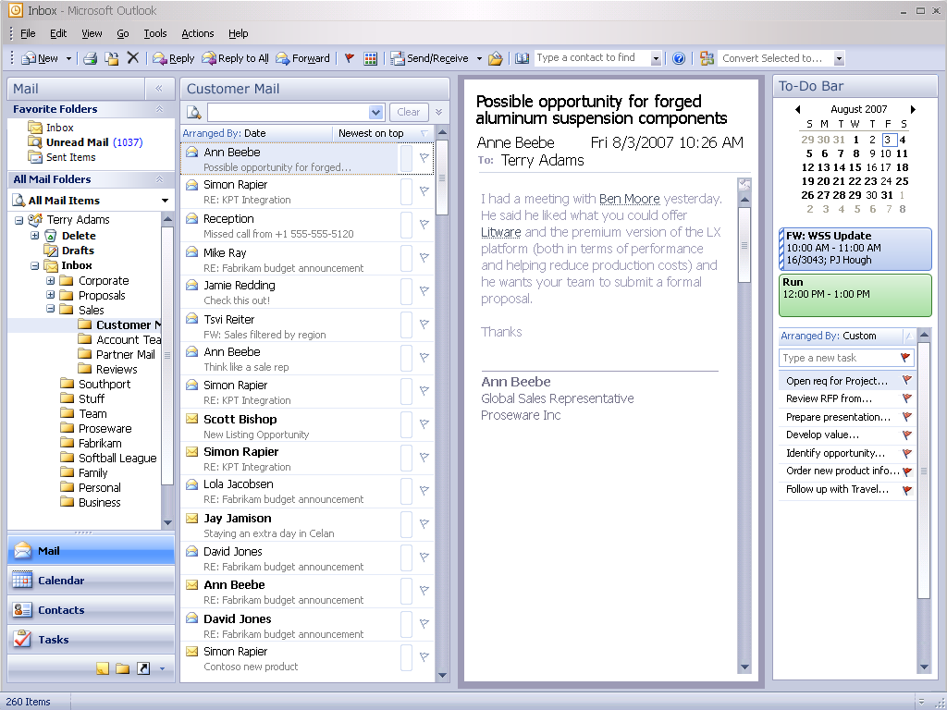
Microsoft Confidential
IW Strategy Review FY06
Notes:
New email concerning a potential opportunity contains smart tags to LOB objects.
Clicking on the Litware smart tag pulls up a Customer 360 panel for Litware.

Slide 31
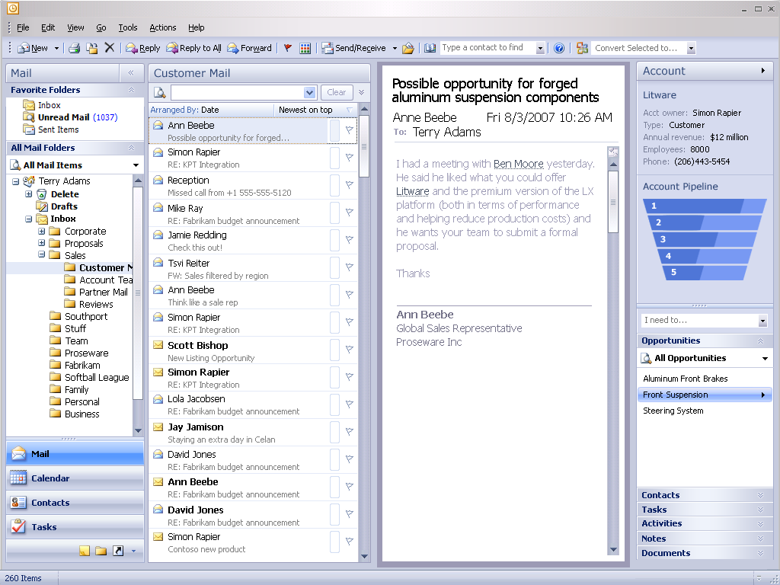
Notes:
The side panel allows access to information related to the Litware account, including active Opportunities.
By right-clicking on an Opportunity in the list, we can attach the current email to it.

Slide 32
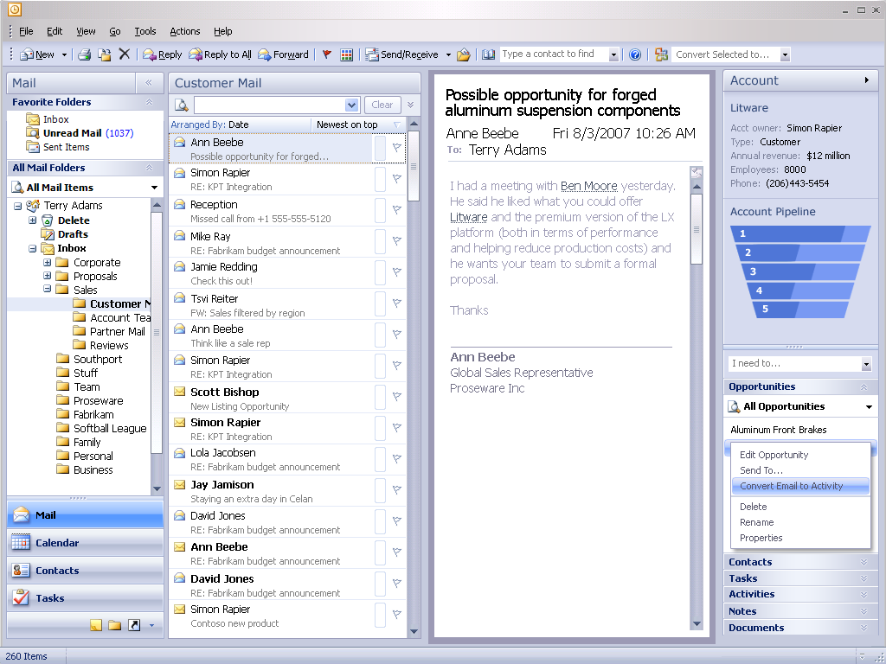
Microsoft Confidential
IW Strategy Review FY06

Slide 33
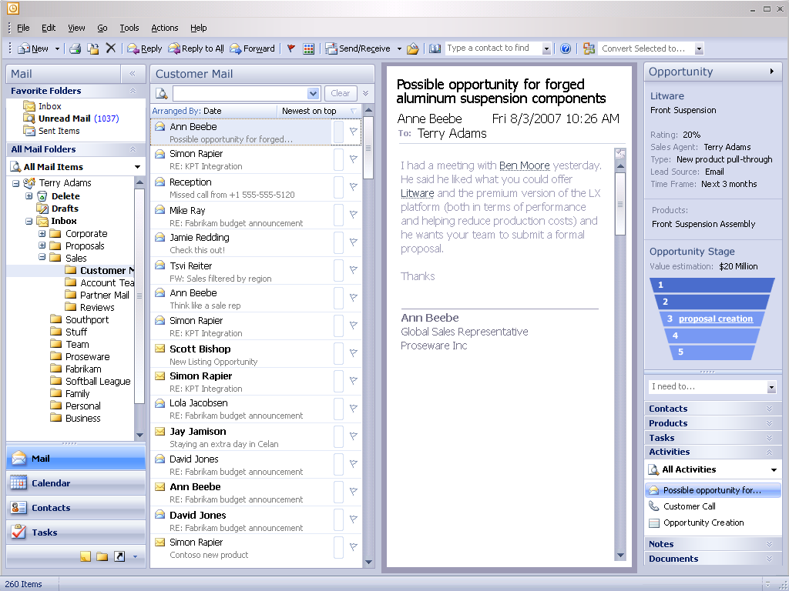
Microsoft Confidential
IW Strategy Review FY06
Notes:
When we have added the email to an existing Opportunity, that Opportunity opens in the panel.

Slide 34
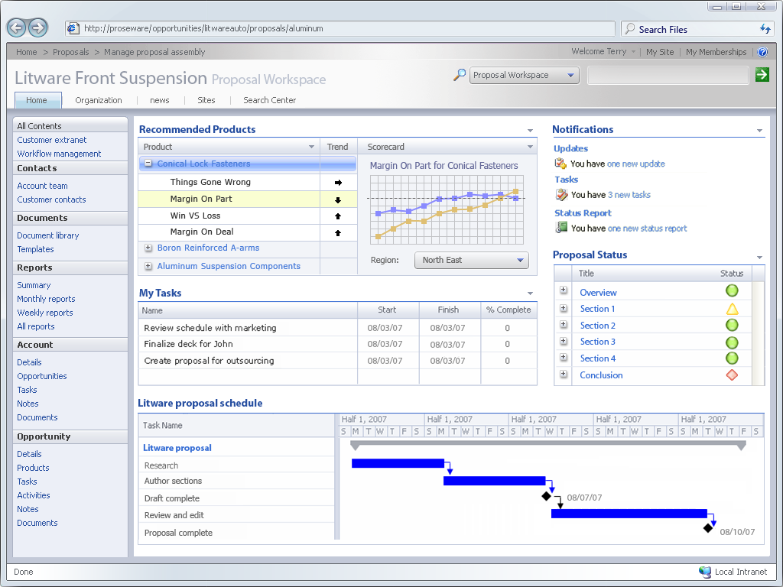
Microsoft Confidential
IW Strategy Review FY06

Slide 35
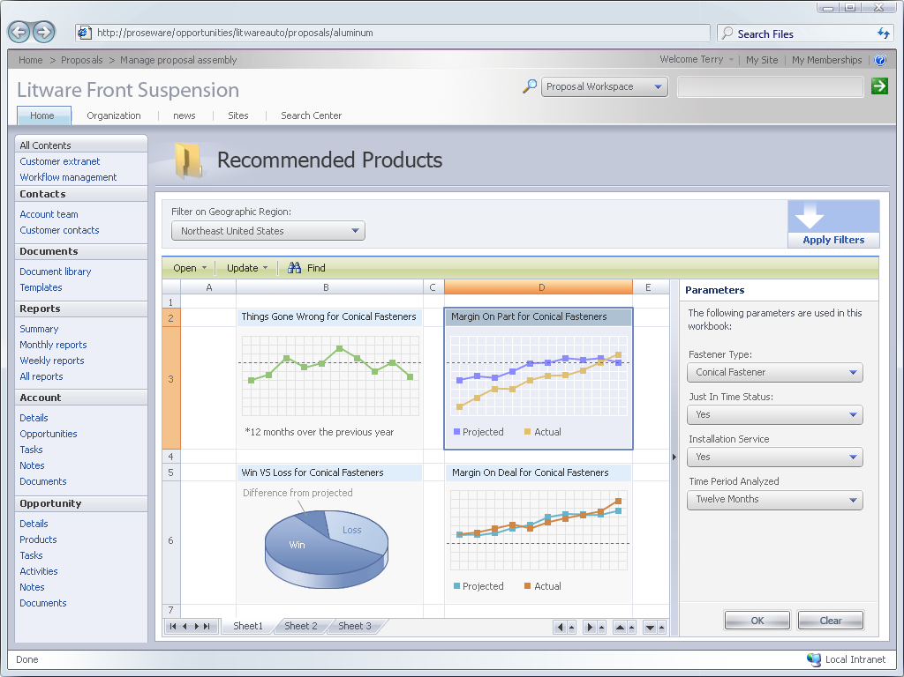
Microsoft Confidential
IW Strategy Review FY06

Slide 36
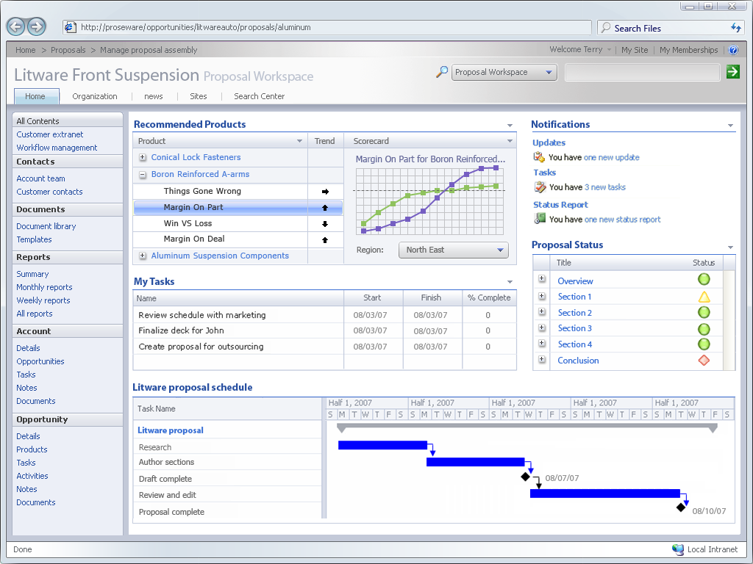
Microsoft Confidential
IW Strategy Review FY06
Notes:
Boron’s margin on part looks good but Terry wants to understand why against the lower win rate. What are those conditions?

Slide 37
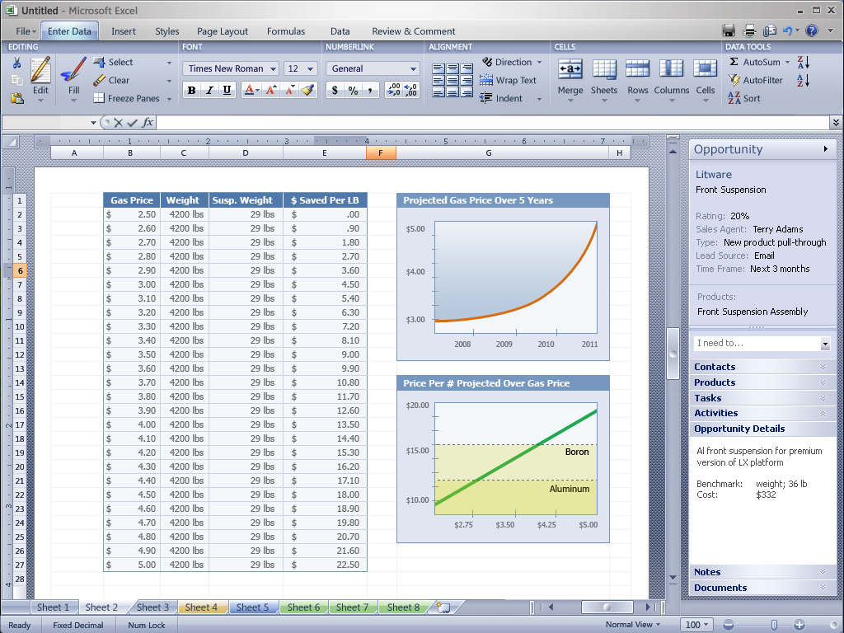
Microsoft Confidential
IW Strategy Review FY06
Notes:
Terry conducts an BI analysis against a number of models including projected fuel prices. Through the magic of Excel and Biz#, Terry can easily visualize the sweet spot for Boron Reinforced A-arms exists at thirteeen dollars when projected gas prices exceed three dollars.

Slide 38
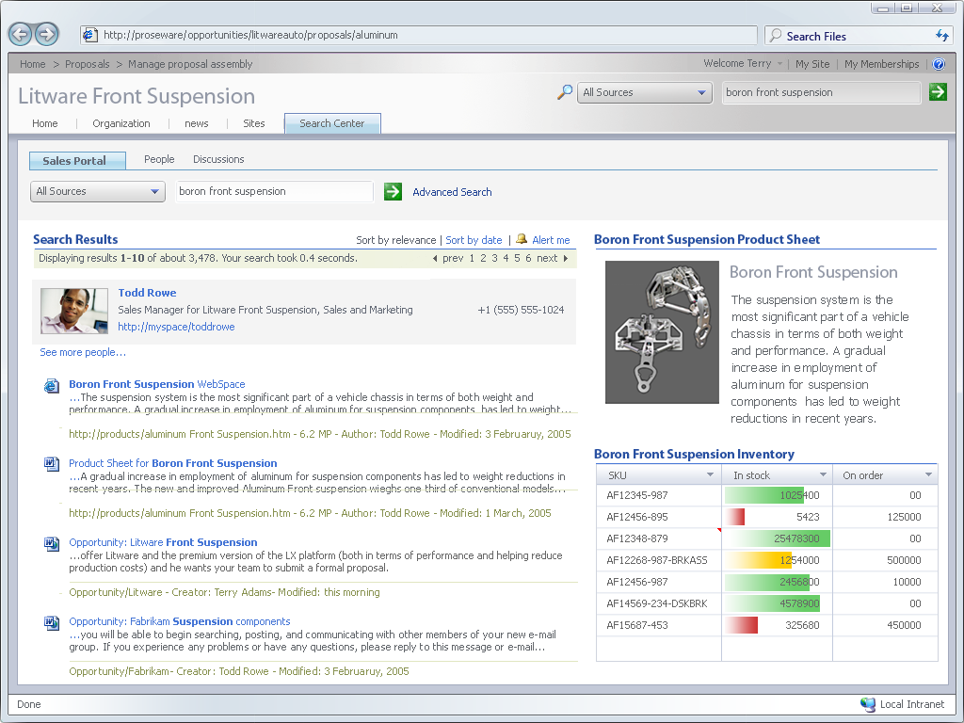
Microsoft Confidential
IW Strategy Review FY06
Notes:
Unified Search tools in SharePoint allow us to search LOB data.
When a search term is recognized as a product, a Product Sheet web part is returned.

Slide 39
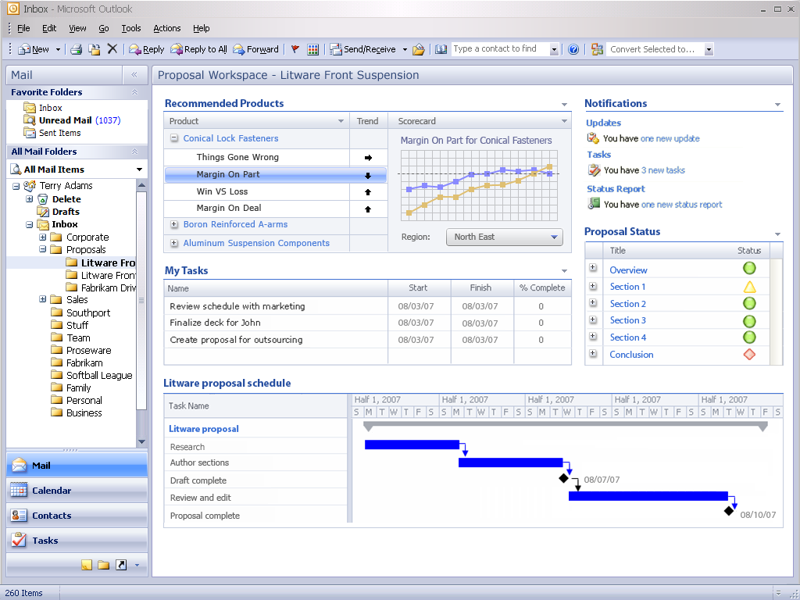
Microsoft Confidential
IW Strategy Review FY06

Slide 40
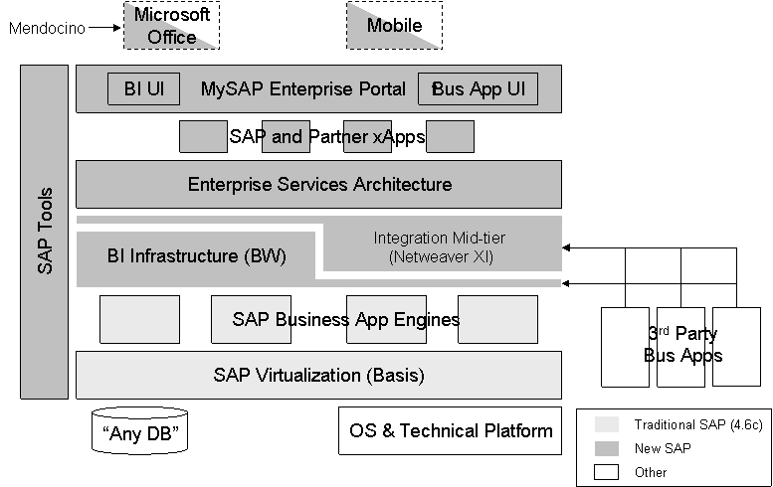
OBA Customer/Competitive Situation
Problems with OLTP apps
Don’t capture real business process
Too brittle / expensive to modify
Poor user experience
Customer Needs / Wants
Composite apps: end-to-end information and processes across functional silos
Office-based user experience for broad usage of business process apps and BI
BI with centrally managed data / business rules and flexible end user reporting & analysis
BI platform that consolidates BI vendors & point solutions
Overriding goal: Better return on LOB investments
Stream-lined business management: more effective decisions and processes with less expense
Competitive Situation
LOB apps consolidating, shifting to suite competition
NetWeaver, Fusion & WebSphere promote more unified messages for app integration and middle-tier
SAP leading in revenue and market share gains
SAP trying to capture more business processes via move to ESA
Pure play BI companies consolidating: Cognos, Hyperion, Business Objects, Ascential purchased by IBM
SAP, Oracle are the long-term BI competitors
Enterprise LOB apps (SAP, Oracle) don’t use Microsoft platform or dev tools
SAP Strategy
A View of SAP’s Strategy
Move toward end users with limited role for Office
Goal to own data and process
Goal to integrate other apps
Proprietary connectivity via ESA
Lagging execution and customer adoption
Similar view for Oracle (less mature)
Successful execution commoditizes / marginalizes the value of our platform & tools
Microsoft Confidential
IW Strategy Review FY06

Slide 41
Office Business Applications
Office 12 Client
OBAf client runtime
Finance
Processes
$8B*
1
Sales/Mktg
Processes
$3.1B*
2
Project
Mgmt/Tracking
Processes
HR
Processes
$1.7B*
*
IT / R&D
Processes
Ops / Logistics
/ Mfg
Processes
$6.6B*
Professional
Services
Processes
Customer
Service
Processes
3
Business Platform = Office 12 SharePoint Server
Office Business Application Framework Services
Microsoft BI
“Indigo” Adapter Framework
.NET Adapters
Web Services
CRM
HR
ERP
SCM
OBA Layer of Business Process
Office Bus App for SAP, Oracle, etc
Office Bus App for MBS
CY06 Adapters:
  SAP
  Siebel
  Oracle/Peoplesoft/JDE
  MBS
Mendocino
3rd Party LOB Back-end
Mendocino is a UX for SAP processes
“OBA” adds significant value by extending processes beyond the LOB, with Office and MS platform
Dynamics is a form of “oba” and provides the entire business application
Microsoft Confidential
IW Strategy Review FY06

Slide 42
Office SharePoint Server as Business Platform
Integrate
Report
Analyze / Plan
Act
Collaborate
User Experience
Documents, views, forms
Customization & document creation tools
Personas: End Users, ISVs
Search /
Outlook
RS/
SharePoint
Excel
SharePoint/
Office
SharePoint/
Office
End User
Tools
Office SharePoint Server—User Experience
Business
Entities
Reports
UDM Content
Business
Processes
Workspaces
Business
Platform
Office SharePoint Server—Platform
High Level Models
Business Semantics
Mapping sources to user context
Business-focused tools
Personas: Analysts, BUIT, ISVs
“BDC”
MDM
“Rubicon”
Excel Svcs.
Biz#
OBA
Framework
Collaboration
“DLC”
Meta-data, Data Models, UDM, RDL
Doc libraries
Win FS
Technology
Platform
SQL Server 2005
WCF /
BTS
WSS
WWF
Develop & Administer
Protocols & binding
Storage
Development tools
Personas: Developers, IT, ISVs
Integration. Svc
Reporting. Svc
Analysis Svc.
Microsoft Confidential
IW Strategy Review FY06

Slide 43
How Microsoft Will Win in Office Business Applications
Business Strategy
Monetize OBA Framework as value in “Office Pro Enterprise”, “Office SharePoint Server”
Office Business Applications: new per user revenue stream (CALs)
Strong support for O12 Enterprise GTM: Business Relevance
Partners: OBA Framework for ISV royalty (not in forecast except Mendocino)
MBS: Sells the entire experience
Roadmap: add additional apps from MS and partners. Go deeper in apps if we can replace the LOB backend over time.
Challenges: sales and service capability, partner relationships, competing with “custom”
Differentiated Offerings
Goals for Office-based Composite Apps
Create a better user experience
Capture the real processes people do
Enable rich experience with cached information
Improve operational decision making with BI insights
Required ingredients
User experience – portal & smart client
Connection to underlying business processes and data
Application middle tier with data & process integration
Evolution & added ingredients
Repository for application objects
More open-ended connectivity via web services
Business logic migrates to mid-tier
BI (reporting & analytics) is integral to business app
Richer UI: both portal and rich client
Support for ad hoc, offline processes with unstructured data (e.g. Search, ECM)
Long-term potential for MBD
Year 1
Year X
OBA
“MS CRM” scales to enterprise and offers reduced costs
Customers see Office as their solution for Business Process with any choice of LOB
Enterprise
SAP
Seibel,
Other.
OBA
MS CRM
Target customers
Map to LOBs
SAP, Oracle: Enterprise/CAS/Upper-Mid
MBS: Small/Medium via MBS own products
Autocad: Small/Medium
OBA
Salesforce
IW
Svcs.
SMB
OBA
MS CRM
Bolster MS CRM value prop in MM
Potential addition of MS Service-focused and service-based OBA offerings for SMB
Microsoft Confidential
IW Strategy Review FY06

Slide 44
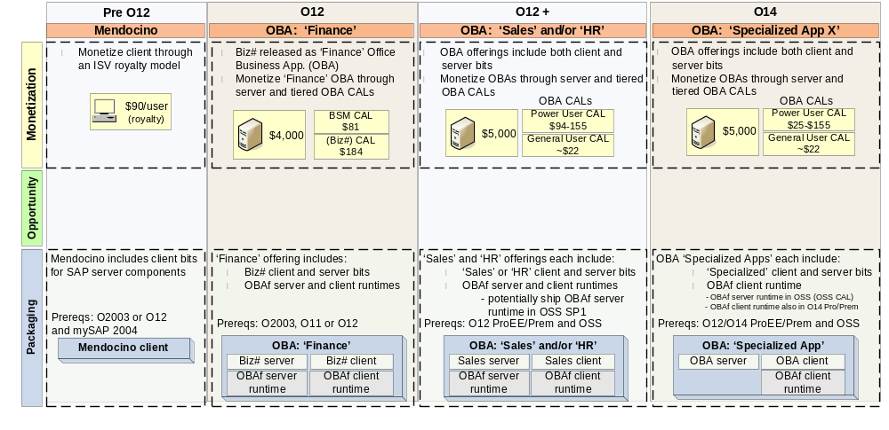





Office Business Applications: Approach Overview
Opportunity: $56B* custom app. development (*US spend, Forrester 2004)→shift part to software licenses
Office play:
Monetize domain specific Office Business Applications through server and tiered OBA CALs
Drive broad adoption of OBAf, Office client and SharePoint Server as part of composite app. platform
* all pricing Select Lvl D w/ SA, per year price
$ Millions, Billed Revenue
* Includes CAL and server revenue
Feb 2006
April 2006
June 2006
Q3 2006
Q1 2007
Q3 2007
Biz# TAP
Mendocino 1.0
Ship
OBA GTM
Plan
Biz# Beta
Biz# v 1.
Ship
OBA: Sales v 1
Ship
Microsoft Confidential
IW Strategy Review FY06

Slide 45
Microsoft Integrated BI Strategy
Re-defining BI
Information & decisions at every level of the org.
Information & analysis in everyday business processes
Simplified packaging and low prices
Broad reach end user tools
Enterprise BI platform
Great Cross-team progress & great collaboration
Excel 12 visualization
Excel interop with SQL-AS
Excel 12 “thin” in SharePoint
SharePoint Report Center with Search
SQLServer 2005 leap forward
Business Scorecard Manager shipped
Adapters for SAP, Siebel, +8 more (end 2006)
Biz# CTPs: MS, Bayer, Lego, Skanska, Amex, Clear Channel, Pepsi, more coming
Performance Mgmt & Financial Apps:
Biz# and Business Scorecard Manager
Applications
Portal & Collab: SharePoint
End-User
Tools
End user
Analysis:
Excel 12
Integration:
SSIS
Analysis:
SSAS
Reporting:
SSRS
Platform
Data Warehouse:
SQL 2005 RDBMS
Marketing/PR progress
Strong cross-team marketing
Analysts get it: AMR (see quote), Forrester, even Gartner
Beginning ramp of “IWIPS” for BI
Gaps / Roadmap
Report integration with Office→complete the mid-tier
End user report/query authoring
Biz# for small/med business→MBS-branded Biz#
“Master Data Management” for BI & Ofc bus apps
Relational DW modeling
Field execution: selling to BDMs, domain expertise, service partnerships
  Means in scope to fix
“The Takeaway: The Microsoft foundation for ubiquitous BI is now in place.
WOW!
But Microsoft Office 12 integration is the real, albeit future story here. Both authors had a one-word response to the demonstration: "Wow!" The interplay of BI and Microsoft Office Suite products, including Outlook, Excel, and SharePoint, went well beyond what we expected and opened our eyes to what is possible. The Takeaway: The walls between everyday work life and the BI fortress might finally be crumbling.”
Microsoft Confidential
IW Strategy Review FY06

Slide 46
BI Business Opportunity
Microsoft Monetization Strategy
Biz# and OBA apps
  incremental MS revenue
  pull platform & end user tools
  increase business relevance
End User Query / Reporting / Analysis:
  Features of SQL & Office
  defend & grow core
  Support new premium CAL
BI Platform:
  Features of SQL
  Defend & grow core
Overall dramatically lower prices than BI competition → greater breadth
Biz# / BSM / OBA
Managers and Analysts
2003 2008
Analytic
Applications
$4.4B $10.7B
Financial
Analytics
$2.1B
CRM
Analytics
$1.5B
Operations
Analytics
$2.6B
Master Data
Management
$4.1B
Packaged
Data Marts
$0.5B
Excel, Office Server
Information Workers
Analysts
End User
Tools
$4.0B $5.1B
Query, Reporting and Analysis
$4.3B
Data Mining
Visualization
$0.8B
SQL
IT Administrators, DBAs
Data Warehouse Management (DBMS)
$6.4B
Data
Warehousing
$5.5B $7.8B
Data Generation (ETL) $1.4B
IDC Data
BI Vendors | Planning | Scorecard
Cognos | $3,500 | $650
BOBJ | n/a | $950
Outlooksoft | $3,500 | n/a
Hyperion | $3,200 | $800
Biz# | $525 | $175
ERP Vendors | Per seat $
SAP Full Prof | $2500
Siebel Prof | $3000
MS-CRM | $600-$800
Dynamics “Professional” user | > $1850
Microsoft Confidential
IW Strategy Review FY06

Slide 47
OBA Follow-ups
BI
  Steveb keynote for BI Strategy Day: meet on strategy and go-to-market
  Field plan to drive BI: Chrisca/Johnma/Mike to drive with Simon/Billv
  Acquisition review with IW Bus Dev, Corp Dev
Office Specialized Uses
  Deep product review on OBAf and apps: Jeff/Bill
  Cross-group vision, plan for Office Server as mid-tier: Kurt/Lewis to lead
  Chris Liddell, Stuart Scott—agree on showcase internal use apps to partner with product groups, deploy, and promote to customers
  Endorse SharePoint as Microsoft’s brand umbrella for the business middle-tier
Investments
  Specialized sales resources (e.g. IWIPS for CRM)
  Marketing
  Product dev
  Funding and executive sponsorship to bootstrap SI support
  Potential acquisitions up to $1.5B to speed field ramp in BI, bootstrap domain “smarts” for apps, and buy or license certified adapters
Microsoft Confidential
IW Strategy Review FY06

Slide 48
Agenda / Schedule
IW Goals and Introduction to Key Topics 9 – 9:30a
1 - Pricing & Packaging Excellence ~9:30 – 11a
2 - Service-based IW offerings ~11:00a – 12:30p
3 - Office Business Apps, BI, LOBi & Specialized Usage ~12:30 – 2p
Summary & Next Steps ~2:00 – 3p
Microsoft Confidential
IW Strategy Review FY06

Slide 49
Other Initiatives
The below initiatives weren’t presented, but are being pursued over the coming year
Initiatives Pursued in Current Plans
 |  | Initiative | Description | Follow-up with Steve or Bill
 | 1. | RTC – VOIP/UC | Communication and Collaboration for the Enterprise, with an emphasis on VoIP | Yes, Provided recent updates
 | 2. | O12 Launch
 | 3. | IW Investment Portfolio Strategy (IWIPS) | Field Resources focused on IW products (IWIPS)
 | 4. | Mobile Productivity Applications | Bobby Kishore investigating opportunities, working cross-MS
 | 5. | O14
 | 6. | IW Adoption | High Value usage to improve information workers’ productivity | Provided recent update
 | 7. | Business Value Discovery | Driving deployment and adoption of software
 | 8. | Competitive campaigns | Includes Notes compete, Google enterprise threats and response | G Compete Memo forthcoming
Included in EV
✓
Not Included in EV
Microsoft Confidential
IW Strategy Review FY06
Notes:
Discuss Follow up actions at SLT meeting
RTC – Owner = Anoop. Discuss follow up actions [add here in notes once decided]
O12 planning Chris Cap owns
IWIPS owned by John Mangalaar email update
BVD was owned by Marc C. Email update or separate meeting
MBS – IW Interoperability integration and innovation. Discuss at SLT action follow up
Mobility – Owned by Bobby. Discuss at SLT action follow up. Not in EV as too early stage to gauge impact.
M&A – Partly included in EV and other areas.
IWAG – Owned by Kim Carnesale. Unclear EV impact at present.
BCC –Broad Customer Adoption. Unclear the EV impact at present.
Competitive review –
Office Wave – Unclear whether this is being acted upon (pursued)

